Slide 1
MartinGarrixFans.com
Team #3
Pat Besser, Andrew Chinique, Javier Diaz, Austin Kim, and
Shay McCarthy
I pledge my honor that I have abided by the Stevens Honor System.

Slide 2
High-Level Description
Navigation Bar
Due to the fact that our website consists of multiple pages, we decided to include a navigation bar which allows for users to freely switch pages easily.
We used the <ul> attribute to create the nav bar and implemented CSS to make noteable what you are on.
Color Scheme
We chose a color scheme of black, grey, and white because it does not cause any problems with legibility.
By applying the color scheme to all of our pages it creates a sense of cohesiveness.
Notes:
Javi

Slide 3
High-Level Description
Home Page - Andrew Chinique
Includes a small gallery of photos, a short biography of Martin Garrix, and links to all of his social media accounts.
When clicked, the images in the gallery are shown within a lightbox. This was done by adding the event “onClick” to the image attribute which then calls a function in the external JavaScript file.

Slide 4
High-Level Description
Media Page - Patrick Besser
Includes a carousel of images that have dynamic caption. This allows for users to be able to read the caption on any size display.
The media page also features videos of Garrix embedded in it which are resized responsively to fit any screen.
Used CSS to run the image carousel on a time interval and manage the size of the caption text automatically based on the display size

Slide 5
High-Level Description
Tour Page - Javier Diaz
Used HTML to create a table that contains information related to what country Garrix will be performing in, along with the date and location. Also, to create buttons that allow the user to interact with the webpage.
Used CSS to style the page to match the color scheme and create flex containers which allow the elements to be placed next to each other. Also, I added media queries to make the web page responsive.
Used JavaScript to give the user the option whether they want to display the average ticket price inside the table mentioned previously, to allow users to comment on the web page anonymously, and to create an interactive voting system.

Slide 6
High-Level Description
Music Page - Shay McCarthy
Features images of Martin Garrix with the artists he has collaborated with over the years, through the use of HTML.
Used CSS to enlarge the images when the user hovers their mouse over them.
Also, embedded in the webpage is Martin’s soundcloud stream where users can find all of his music in one place.

Slide 7
High-Level Description
Shop Page - Austin Kim
Used HTML to link the action of clicking on an article of clothing to the redirection of the user to a site to purchase the item. This function allows the images to act as URLs which makes the page more appealing to the user.
Minimalistic design was implemented in order to simplify the user-to-website interaction and allow quick and easy access to the merchandise.
Hover action allows for highlighting of the merchandise to better indicate which item is being selected

Slide 8
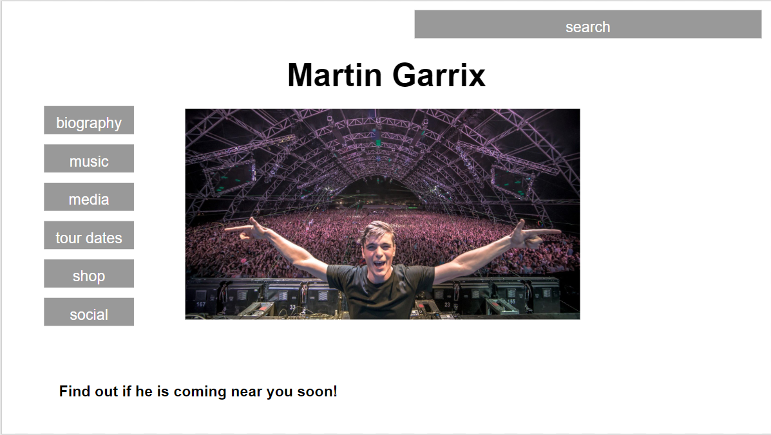
Preliminary Sketch Design
Notes:
Pat

Slide 9

Demonstration Video
Notes:
Andrew

Slide 10
HTML Element Discussion
<head>
<body>
<title>
<div>
<ul>
<li>
<figure>
<img>
<br>
<figcaption>
<h1>
<h2>
<h3>
<slider>
<slide>
<iframe>
<table>
<tr>
<td>
<th>
<button>
<input>
<p>
<script>
<a>
<link>
Notes:
Pat

Slide 11
HTML Element Discussion
<div>
Used to divide html code into manageable sections and maximize responsiveness.
<ul>,<li>
Used to create the navigation bar featured on all web pages.
<img>
Used to display media.
<a>
Used to create hyperlinks to external websites.
Notes:
Pat

Slide 12

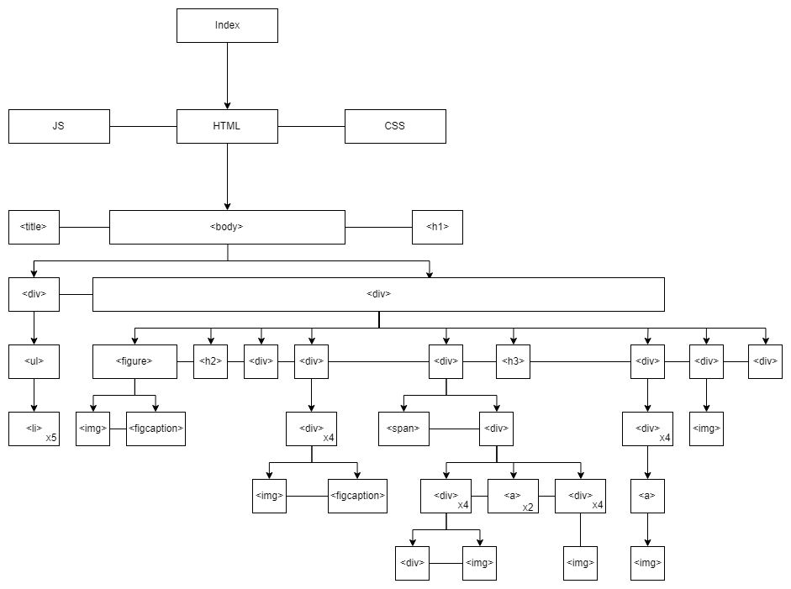
DOM Diagram Illustration

Slide 13
CSS-Based Formatting Discussion
align-items
animation
animation-delay
background-color
background-attachment
background-image
background-size
background-repeat
background-position
border
border-bottom
border-collapse
box-shadow
color
display
flex-wrap
flex-direction
float
font-size
font-family
font-weight
font-style
grid-template-columns
grid-template-rows

Slide 14
CSS-Based Formatting Discussion
height
justify-content
left
list-style-type
overflow
margin-right
margin-left
margin-top
margin-bottom
max-width
max-height
padding
padding-top
padding-bottom
padding-right
position
text-align
text-decoration
top
vertical-align
width
z-index

Slide 15
CSS-Based Formatting Discussion
animation-delay
specifies a delay for the start of an animation
defined in seconds or milliseconds
z-index
controls the vertical stacking order of elements that overlap
only work on positioned elements
higher the z-index the closer to the front it will appears
values can be positive or negative
grid-template
row and column used
Specifies the number of heights and widths in a grid layout
flex
wrap and direction used
specifies how a flex item will grow or shrink to fit the space available in its flex container

Slide 16
JavaScript Functionality Discussion
Home Page
Utilizes Javascript in order to display the gallery images in a lightbox when clicked on.
Functions Include:
openModal() - getElementById is applied to “myModal” to apply the style display=”block”
closeModal() - getElementById is applied to “myModal” to apply the style display=”none”
plusSlides() - adds slides to the index of the showSlides() function
currentSlide() - shows the current slide
showSlides() - function used to change slides and displays.
Notes:
Austin

Slide 17
JavaScript Functionality Discussion
Tour Page
Inserts an anonymous comment section..
Gives the user an option whether or not they want to view the average ticket price.
Implemented a voting system to decide Martin Garrix’s next concert location.
Functions Include:
modifyBars() - adjusted the bars according to the percentages of the votes for each section
UnitedStates() - added a vote to the total and US votes
Italy() - added a vote to the total and Italy votes
France() - added a vote to the total and France votes
displayprice() - alters the visibility of the average ticket price
displayvotes() - displays the results of the votes
submitComment() allows for comment submissions
Notes:
Austin

Slide 18
Contributions
Pat
Media page (HTML, CSS)
High-level description
DOM diagram
Andrew
Home page (HTML, CSS, JS)
Standardized page style
DOM diagram
Github Repo Manager
Javier
Tour Page (HTML, CSS, JS)
Navigation Bar
High-Level Description
Austin
Shop page (HTML, CSS)
JavaScript Functionality Discussion
Shay
Music page (HTML, CSS)
CSS-Based Formatting Discussion

Slide 19


Github Repository
https://github.com/timid-one/cs-146-final-project.git
Tested in Chrome

